Slide 1
Starch calculation
03.06.2026

Slide 2
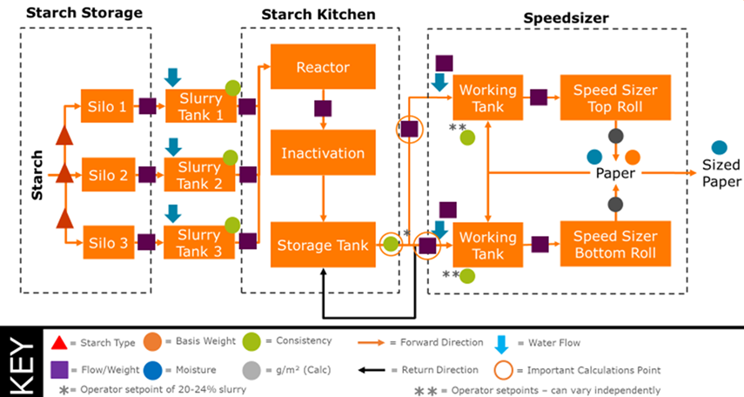
Starch process
C

Slide 3
Bone Dry Starch
(Starch flow BR+ Dillution flow BR)*consistency of the bottom roll = Bone Dry Starch Bottom Roll
(2-033-FI100-X+2-033-FC100-X)*2-033-QI100-02*10= Bone Dry Starch Bottom Roll (kg)
Bone Dry Starch Bottom roll/ Starch flow = Consistency main pipe
Bone Dry Starch Bottom Roll/ 2-033-FI100-X/10= Consistency main pipe (%)
Consistency main pipe * Starch flow TR = Bone Dry Starch Top Roll
Consistency main pipe*2-033-FI200-X*10=Bone Dry Starch Top Roll (kg)

Slide 4
Starch Uptake
Bone Dry Starch * Production rate = Specific starch uptake (kg/T)
Bone Dry Starch BR or TR * PRODUCTION-RATE=Specific starch uptake (kg/T)
Width * speed of the groupe 7= Square meters produced per hour (m^2/h)
QO-REEL-CURR-AVG-WEBWIDTH/100*2-008-VPOPE-AR0*60= Square meters produced per hour (m^2/h)
Bone Dry Starch/ Square meters produced per hour= Starch Uptake (g/m^2)

